Slide 1
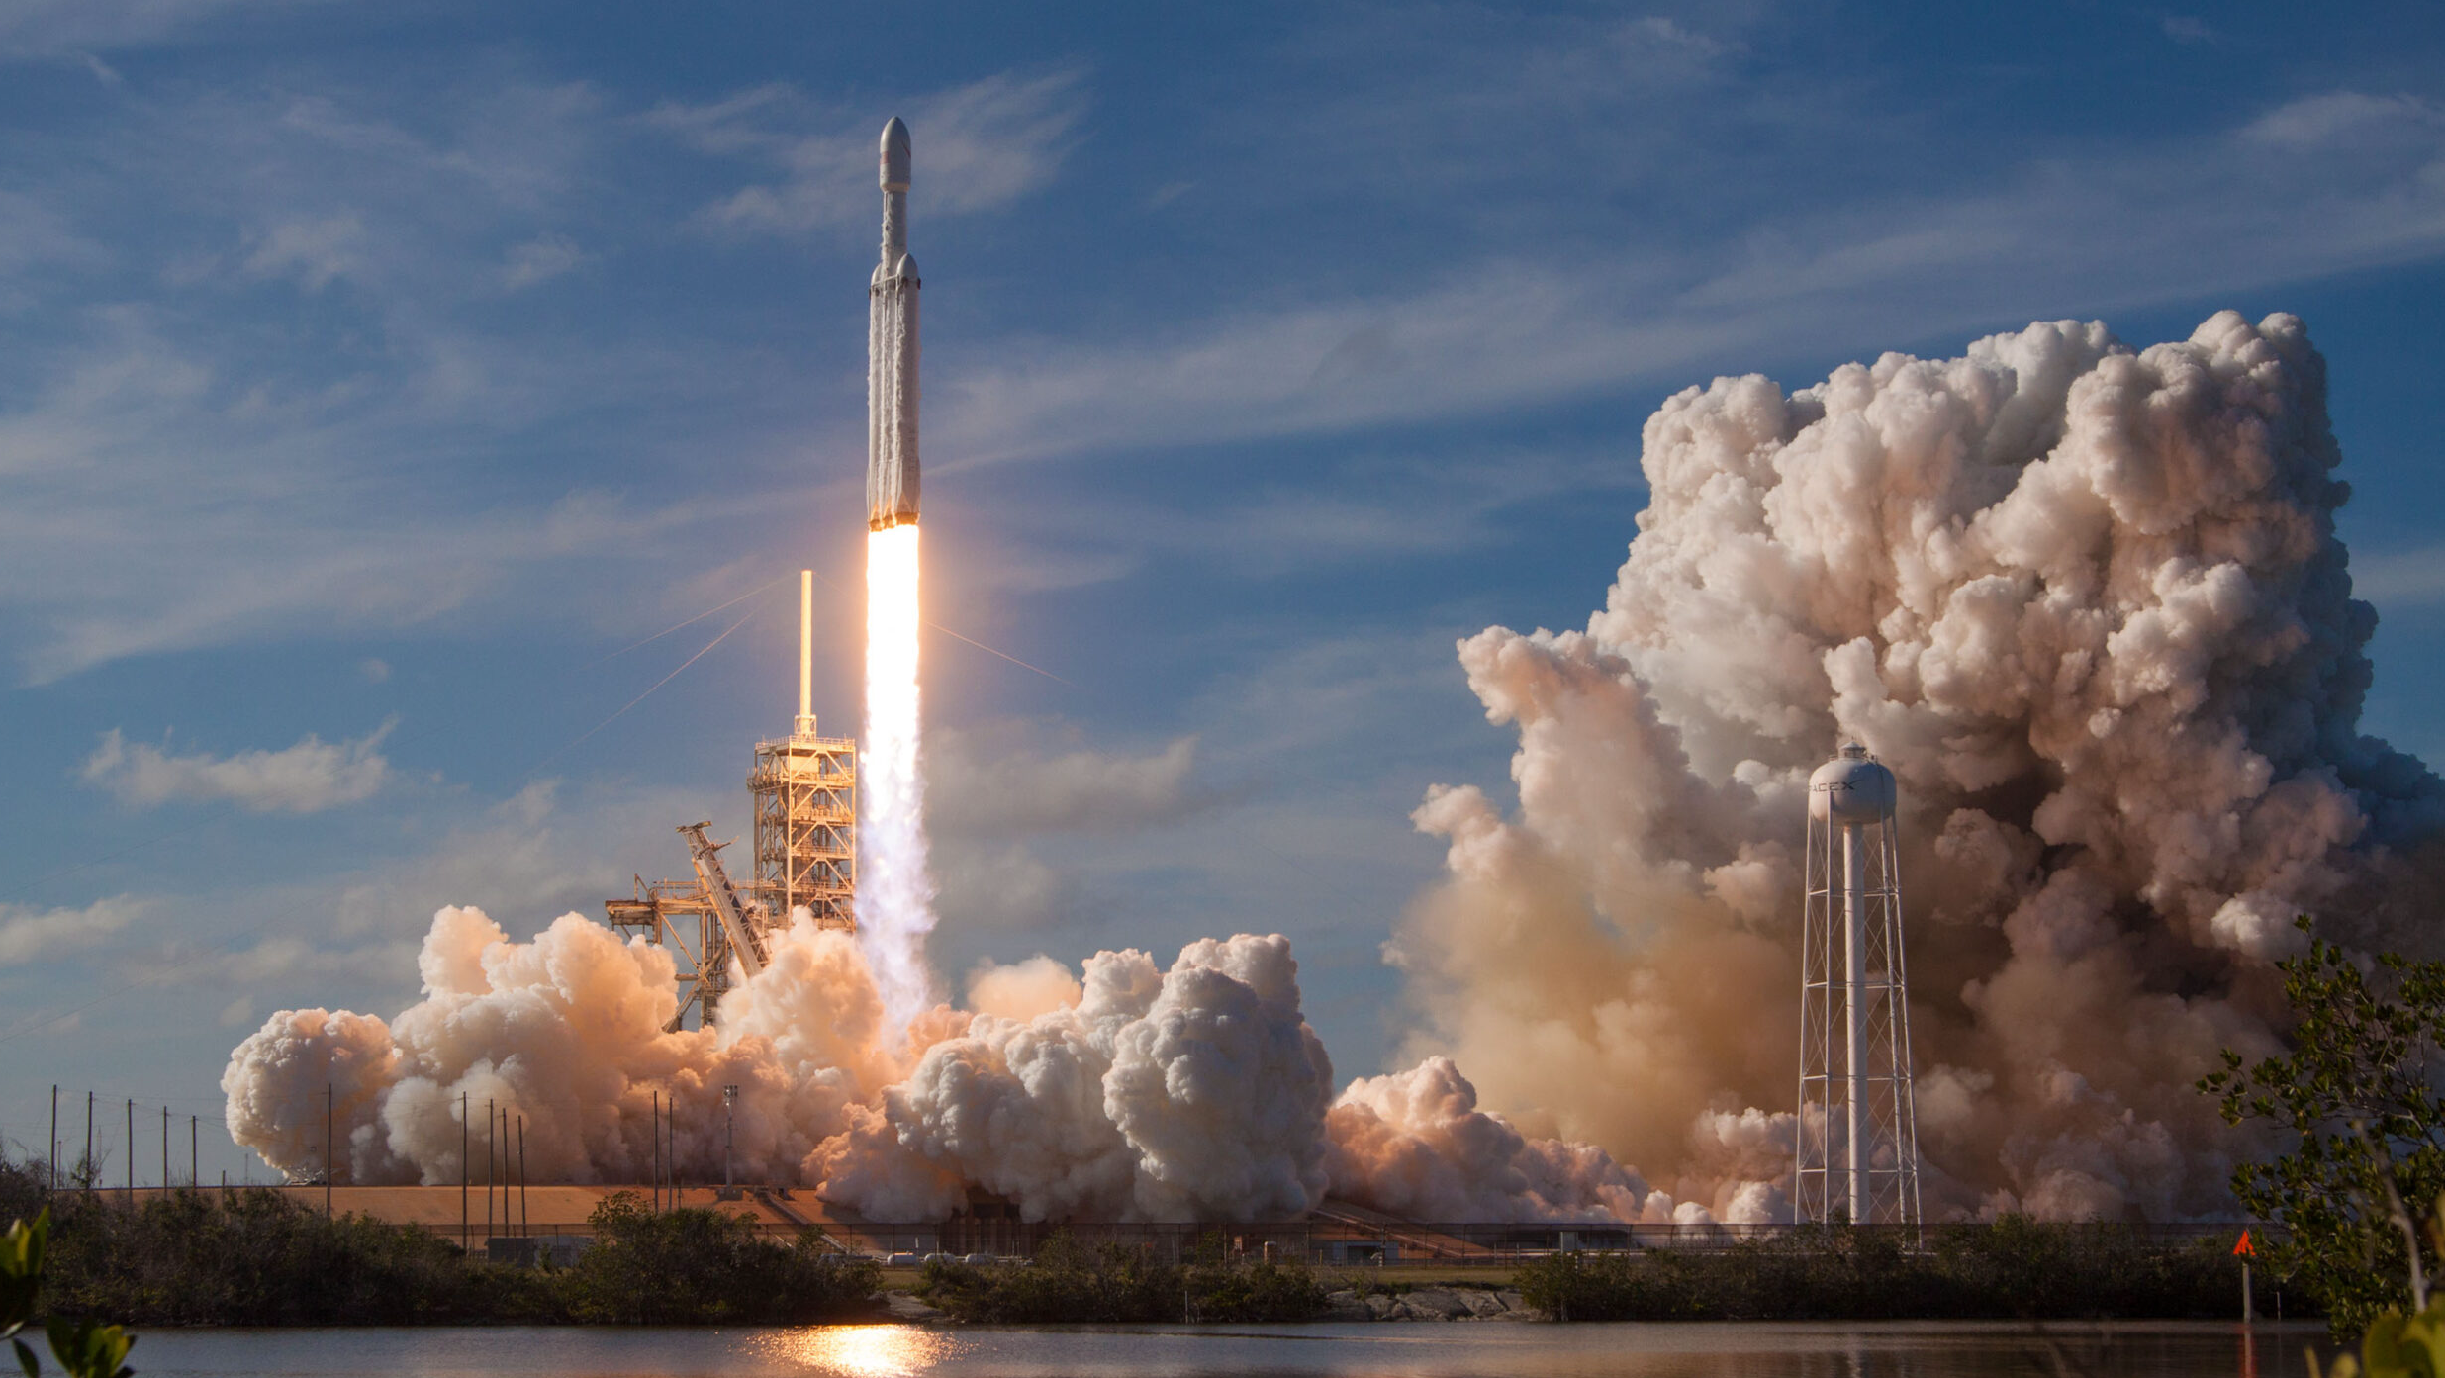



Data Science Professional Certificate Capstone Project
Hayford Osumanu
February 2023

Slide 2


OUTLINE
Executive Summary
Introduction
Methodology
Results
Discussion
Conclusion
Appendix

Slide 3
Outline
EXECUTIVE SUMMARY
The primary objective of this Capstone Project is to predict if SpaceX Falcon 9 first stage will land successfully using Machine Learning Classification Algorithms. The goal is to analyze Space X Falcon 9 dataset collected from various to help provide insight for decision making.
In order to achieve the above-mentioned objective, the analyst collected using API and Web Scrapping. The data was transformed using Data Wrangling techniques.
Both descriptive and inferential data analysis was used to help understand and infer from the data. The main analytical tools used for the descriptive analysis was SQL and Python. Interactive visuals such as folium maps, dashboard plotly was built to help analyze launch site proximity. Besides, Machine Learning Classification algorithm was used to predict if the first stage of Falcon 9 will land successfully.
From the analysis, it was observed that, variable such as launch site have a significant impact with the outcome of the launches (success or failure).
Besides, Launch Site ‘KSC LC-39A’ recorded the highest launch success rate whereas Launch Site ‘CCAFS SLC- 40’ recorded the lowest launch success rate.
In addition, Orbits ES-L1, GEO, HEO, and SSO recorded the highest launch success rates whereas orbit GTO the least. Strategically, Lunch sites are located away from the cities and much closer to coastline, railroads, and highways.
More importantly, the best performing Machine Learning Classification Model was the Decision Tree with an accuracy of about 87.5%. When the models were tested on the test data, the accuracy score was about 83% for all models. Perhaps, more data may be needed to further tune the models and find a potential better fit or reduce curse of dimensionality.
This and more other interesting observations and discussions have been exhausted in this report.

Slide 4
Outline
INTRODUCTION
SpaceX advertises Falcon 9 rocket launches on its website with a cost of 62 million dollars; other providers cost upward of 165 million dollars each, much of the savings is because SpaceX can reuse the first stage.
Therefore, if we can determine if the first stage will land, we can determine the cost of a launch. This information can be used if an alternate company wants to bid against SpaceX for a rocket launch.
The goal of this project is to:
• Write Python code to manipulate data in a Pandas data frame
• Convert a JSON file into a Create a Python Pandas data frame by converting a JSON file
• Create a Jupyter notebook and make it sharable using GitHub
• Use data science methodologies to define and formulate a real-world business problem.
• Use your data analysis tools to load a dataset, clean it, and find out interesting insights from it.

Slide 5
Outline
Data Collection and ML Tools
The methods used in data collection, descriptive and inferential analysis are follows:
Data collection, wrangling, and formatting
SpaceX API
Web scraping
Exploratory data analysis (EDA)
Pandas and NumPy
SQL
Data visualization
Matplotlib and Seaborn
Folium
Dash
Machine learning prediction
Logistic regression
Support vector machine (SVM)
Decision tree
K-nearest neighbors (KNN)

Slide 6
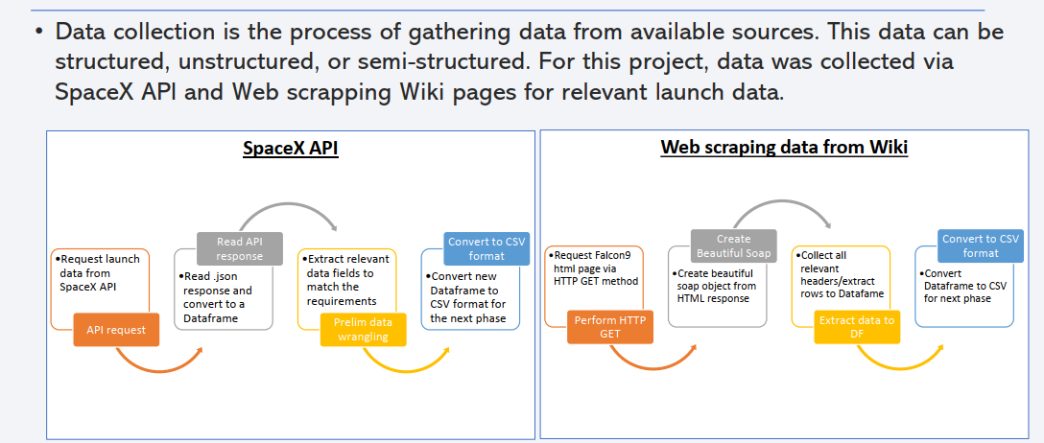
Outline
METHODOLOGY
Data collection, wrangling, and formatting
1

Slide 7
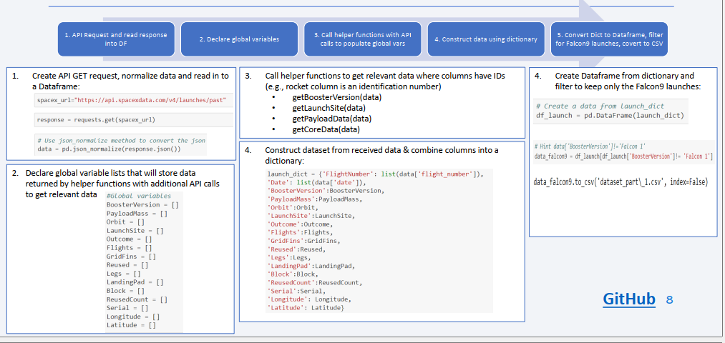
Outline
METHODOLOGY
Data collection, wrangling, and formatting
2

Slide 8
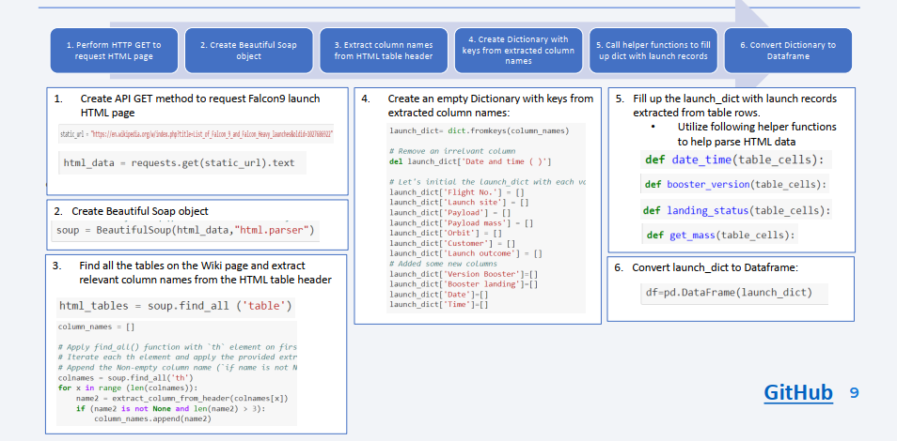

Outline
METHODOLOGY
Data collection, wrangling, and formatting
3

Slide 9
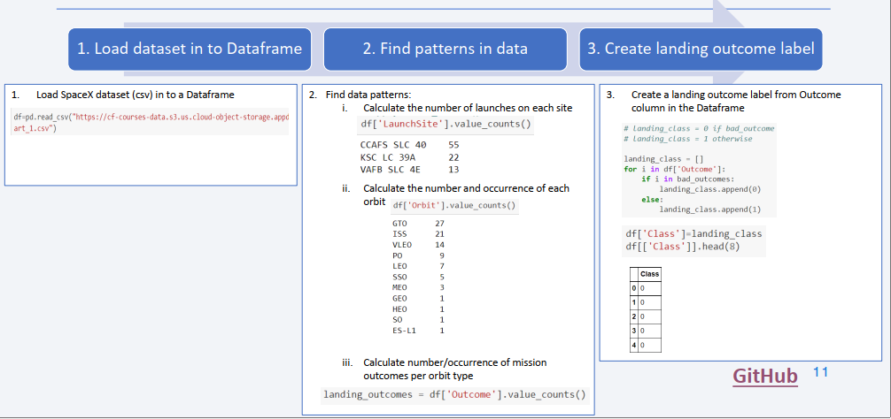
Outline
METHODOLOGY
Data collection, wrangling, and formatting
4

Slide 10
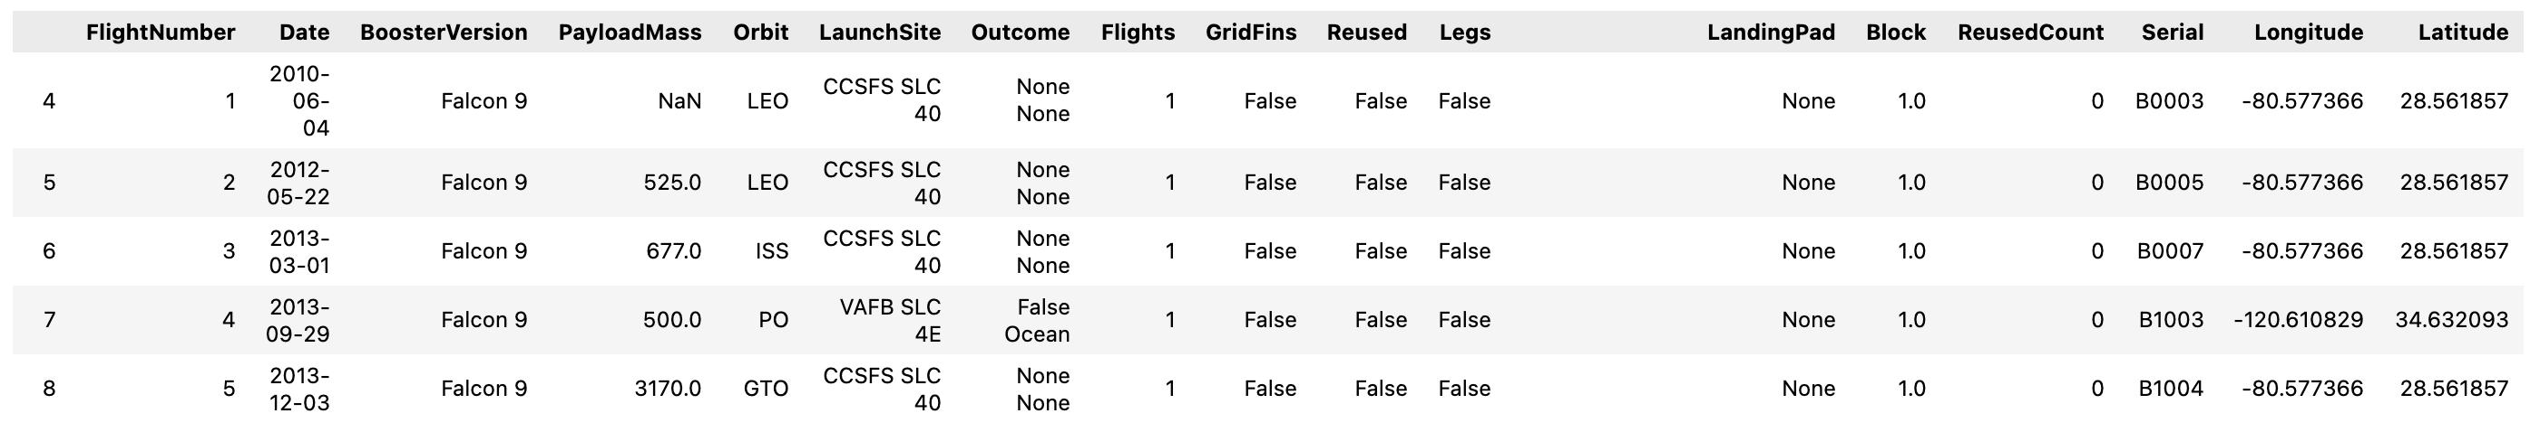
Outline
METHODOLOGY
Data collection, wrangling, and formatting
5
SpaceX API
The API used: https://api.spacexdata.com/v4/rockets/.
The API provided data about many types of rocket launches done by SpaceX; the data was therefore filtered to include only Falcon 9 launches.
Missing value in the dataset was replace by the column mean.
We ended with 90 rows and 17 columns or features. The table below shows the first few rows of the data:

Slide 11

Outline
METHODOLOGY
Data collection, wrangling, and formatting
6
Web scraping
The data is scraped from https://en.wikipedia.org/w/index.php?title=List_of_Falcon_9_and_Falcon_Heavy_launches&oldid=1027686922
The website contains only the data about Falcon 9 launches.
We ended up with 121 rows and 11 columns or features. The table below shows the first few rows of the dataset:

Slide 12



Outline
METHODOLOGY
Exploratory Data Analysis (EDA)
7
Pandas and NumPy
Function from Pandas and NumPy libraries were used to obtained basic information such as:
The number of launches on each launch site
The number of occurrence of each orbit
The number and occurrence of each mission outcome
SQL
Data was queried using SQL to answer several questions such as:
The names of the unique launch sites in the space mission
The total payload mass carried by boosters launched by NASA (CRS)
The average payload mass carried by booster version F9 v1.1

Slide 13



Outline
METHODOLOGY
Data Visualization
8
Matplotlib and Seaborn
Functions from the Matplotlib and Seaborn libraries were used to visualize the data using scatterplots, bar charts, and line charts to help answer questions such as.
The relationship between flight number and launch site
The relationship between payload mass and launch site
The relationship between success rate and orbit type
Folium
Functions from the Folium libraries were used to visualize the data through interactive maps to help:
Mark all launch sites on a map
Mark the succeeded launches and failed launches for each site on the map
Mark the distances between a launch site to its proximities such as the nearest city, railway, or highway

Slide 14


Outline
METHODOLOGY
Data Visualization
9
Dash
Functions from Dash were used to generate an interactive site where we can toggle the input using a dropdown menu and a range slider. The interactive site shows:
The total success launches from each launch site
The correlation between payload mass and mission outcome (success or failure) for each launch site

Slide 15

Outline
METHODOLOGY
Machine Learning Prediction
10
Machine Learning Modeling
Functions from the Scikit-learn library were also used to create machine learning models.
The machine learning prediction include the following steps:
Standardizing the data
Splitting the data into training and test data
Creating machine learning models using:
Logistic regression
Support vector machine (SVM)
Decision tree
K nearest neighbors (KNN)
Fit the models on the training set
Find the best combination of hyperparameters for each model
Evaluate the models based on their accuracy scores and confusion matrix

Slide 16


Outline
RESULTS
The results of the analysis were grouped into 5 parts:
SQL (EDA with SQL)
Matplotlib and Seaborn (EDA with Visualization)
Folium
Dash
Predictive Analysis
The target variable was Outcome with class 0 represents a failed launch outcome while class 1 represents a successful launch outcome.

Slide 17
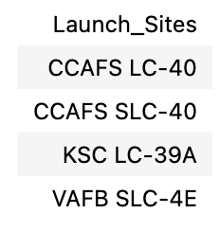
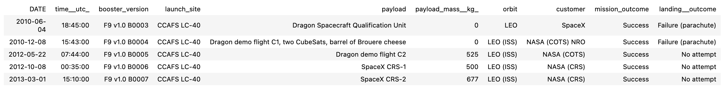
Outline
RESULTS
SQL (EDA with SQL)
1
SQL Query Results:
List of unique launch sites in the space mission
Five records where launch sites begin with ‘CCA’

Slide 18
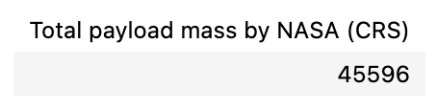
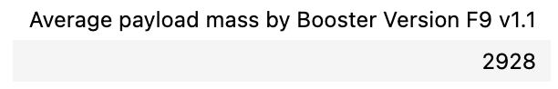
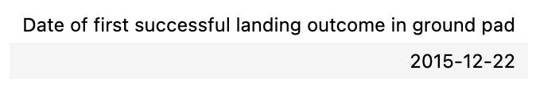
Outline
RESULTS
SQL (EDA with SQL): Payload Mass Carried by Boosters
2
The total payload mass carried by boosters launched by NASA (CRS)
The average payload mass carried by booster version F9 v1.1
The date when the first successful landing outcome in ground pad was achieved

Slide 19
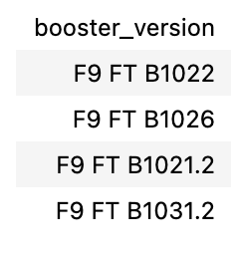
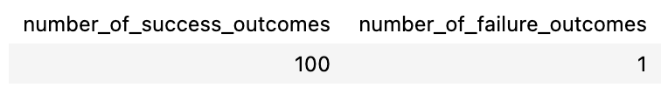
Outline
RESULTS
SQL (EDA with SQL): Boosters and Payload Mass
3
List of boosters which have success in drone ship and have payload mass greater than 4000 but less than 6000
The total number of successful and failure mission outcomes

Slide 20
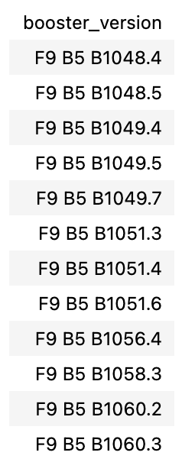
Outline
RESULTS
SQL (EDA with SQL): Booster Versions with Maximum Payload Mass
4
List of booster versions which have carried the maximum payload mass

Slide 21
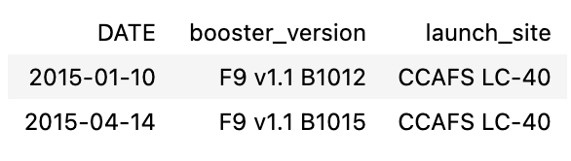
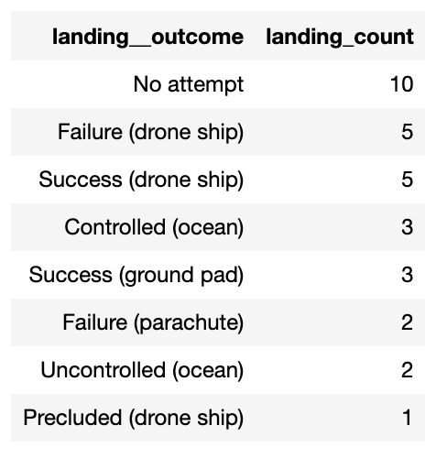
Outline
RESULTS
SQL (EDA with SQL): Failed Landing Outcomes and Dates
5
Failed landing outcomes in drone ship, their booster versions, and launch site names for in year 2015
Count of landing outcomes between the date 2010-06-04 and 2017-03-20, in descending order

Slide 22
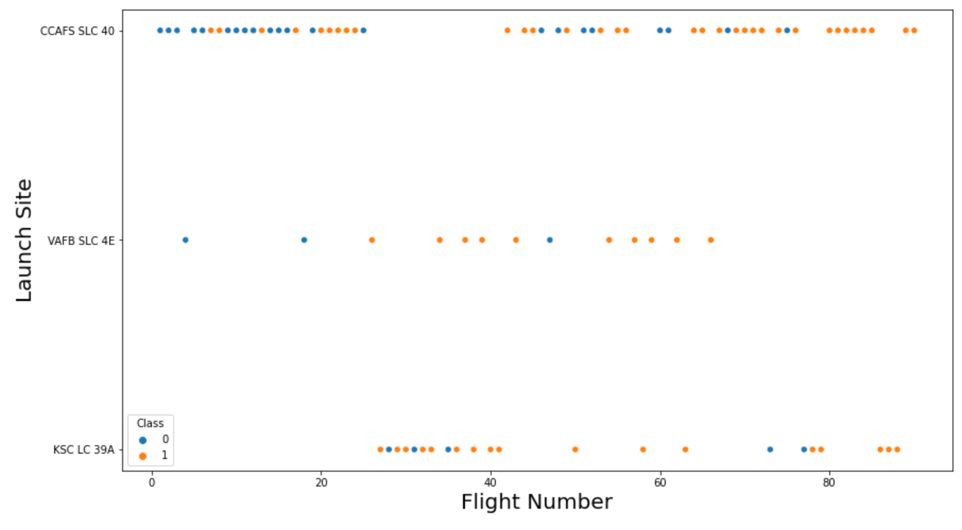
Outline
RESULTS
EDA Visualization: Flight Number and Launch Site
6
The relationship between flight number and launch site
Observation
Success rates (Class=1) increases as the number of flights increase
For launch site ‘KSC LC 39A’, it takes at least approximately 25 launches before a first successful launch.

Slide 23
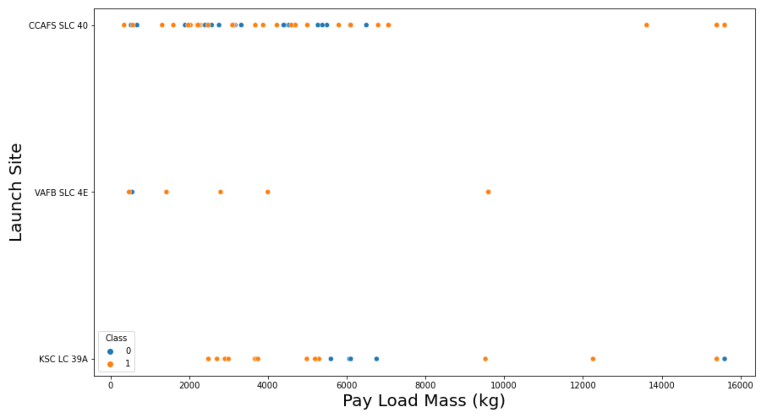
Outline
RESULTS
EDA with Visualization: Relationship Between Payload Mass and Launch Site
7
The relationship between payload mass and launch site
Observation
For launch site ‘VAFB SLC 4E’, it appears there is no rockets launched for payload greater than 10,000 kg
The proportion of successful launch (Class=1) increases for launch site ‘VAFB SLC 4E’ as the payload mass increases
There is little or no correlation or pattern between launch site and payload mass

Slide 24
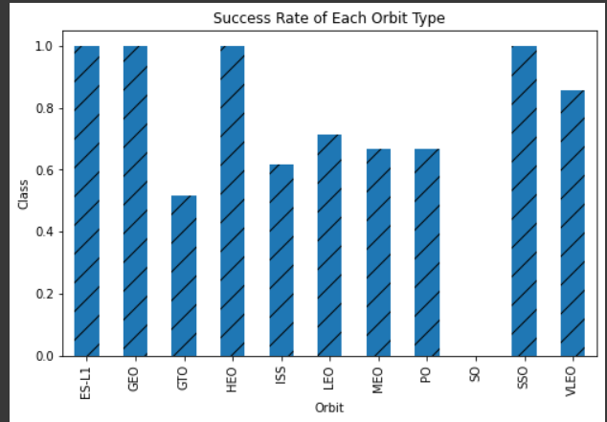
Outline
RESULTS
EDA with Visualization: Success Rate and Orbit Type
8
Relationship between success rate and orbit type
Observation
Orbits ES-LI, GEO, HEO, and SSO have the highest success rates whereas GTO orbit has the least success rate.

Slide 25
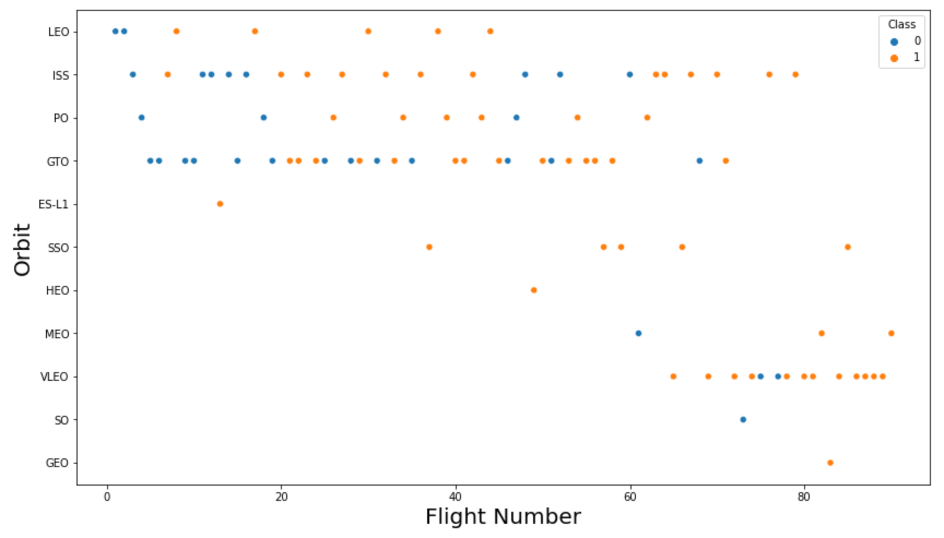
Outline
RESULTS
EDA with Visualization: Flight Number and Orbit Type
2
Relationship between flight number and orbit type
Observation
Orbit VLEO first successful landing (class=1) doesn’t occur until 60+ number of flights
For most orbits (LEO, ISS, PO, SSO, MEO, VLEO) successful landing rates appear to increase with flight numbers
It looks like there is no relationship between flight number and orbit for GTO

Slide 26
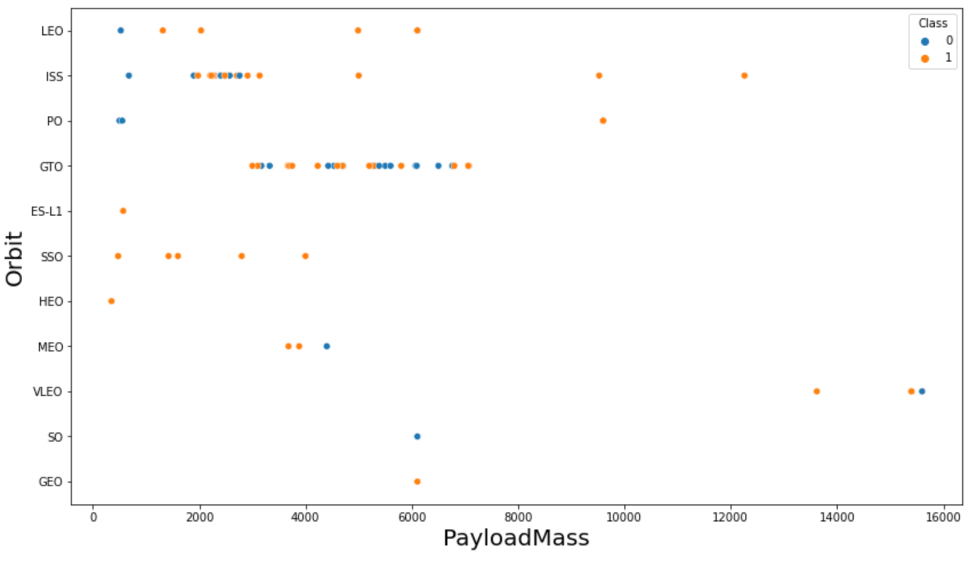
Outline
RESULTS
EDA with Visualization: Payload Mass and Orbit Type
9
Relationship between payload mass and orbit type
Observation
Successful landing rates (Class=1) appears to be slightly increased with pay load for orbits LEO, ISS, PO, and SSO
For GEO orbit, there is no clear pattern between payload and orbit for successful or unsuccessful landing

Slide 27
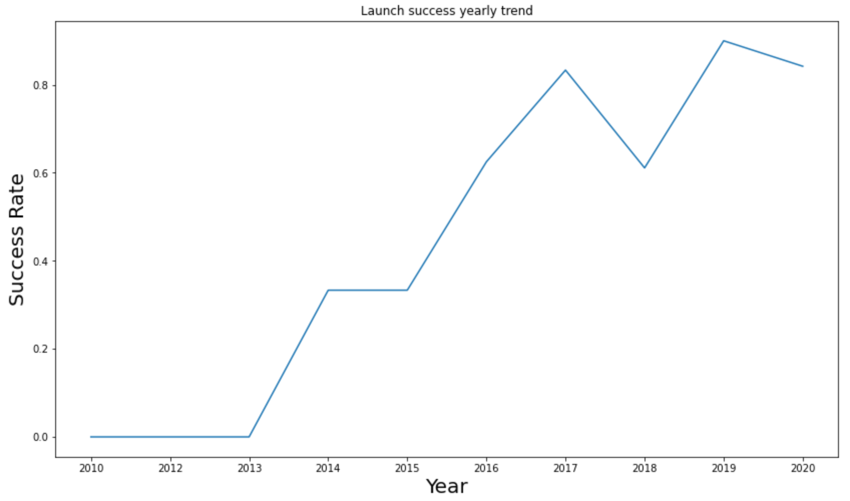
Outline
RESULTS
EDA with Visualization: Launch success yearly trend (2010-2020)
10
The launch success yearly trend
Observation
Success rate (Class=1) increased by about 80% between 2013 and 2020
Success rates was virtually the same between 2010 to 2013 and between 2014 to 2015.
Success rates decreased between 2017 to 2018 and between 2019 to 2020, respectively.
There is a linear (upward trend) relationship between success rate and year of launch.

Slide 28

Outline
RESULTS
Folium: Map of All Space X Falcon 9 Launch Sites
1
All launch sites on map

Slide 29
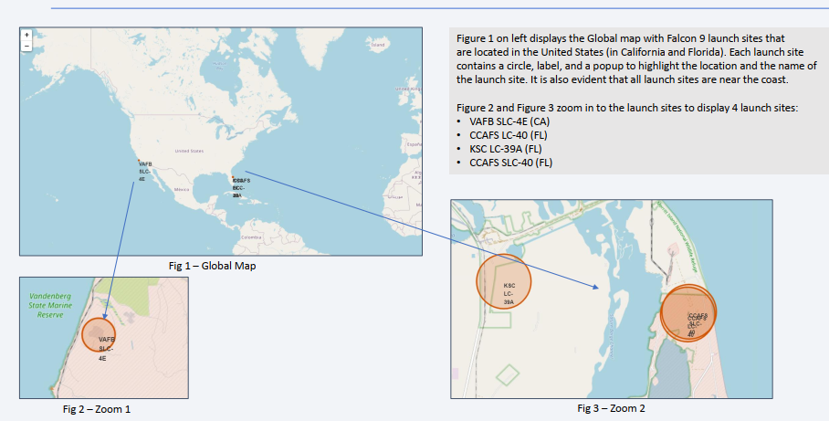
Outline
RESULTS
Folium: Map of All Space X Falcon 9 Launch Sites
2
All launch sites on map

Slide 30
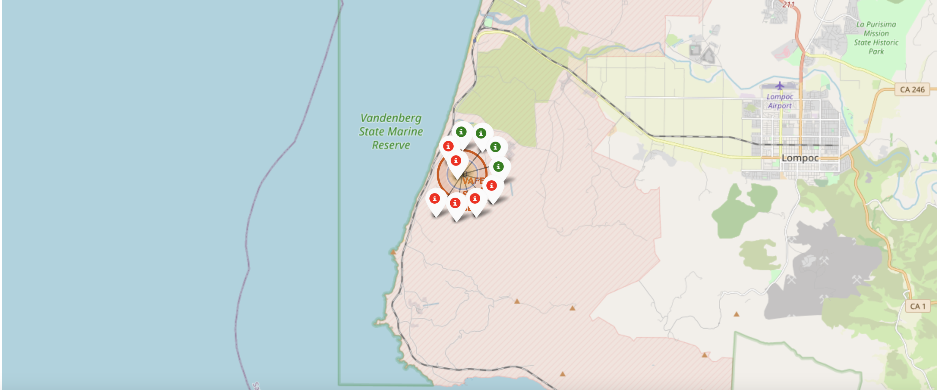
Outline
RESULTS
Folium: Map of Successful and Failed Launch Sites
3
The succeeded launches and failed launches for each site on map
If we zoom in on one of the launch site, we can see green and red tags. Each green tag represents a successful launch while each red tag represents a failed launch

Slide 31
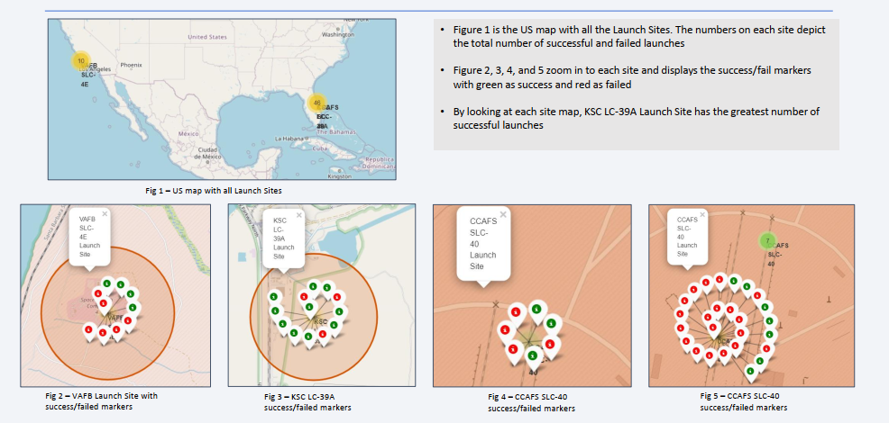
Outline
RESULTS
Folium: Map of Successful and Failed Launch Sites
4
Observation
Figure 1 shows the US map with all the Launch Sites. The numbers on each site displays the total number of successful and failed launches.
Figure 2, 3, 4, and 5 below shows a zoom picture of each site and displays the success/fail markers with green as success and red as failed
KSC LC-39A Launch Site has the greatest number of successful launches

Slide 32
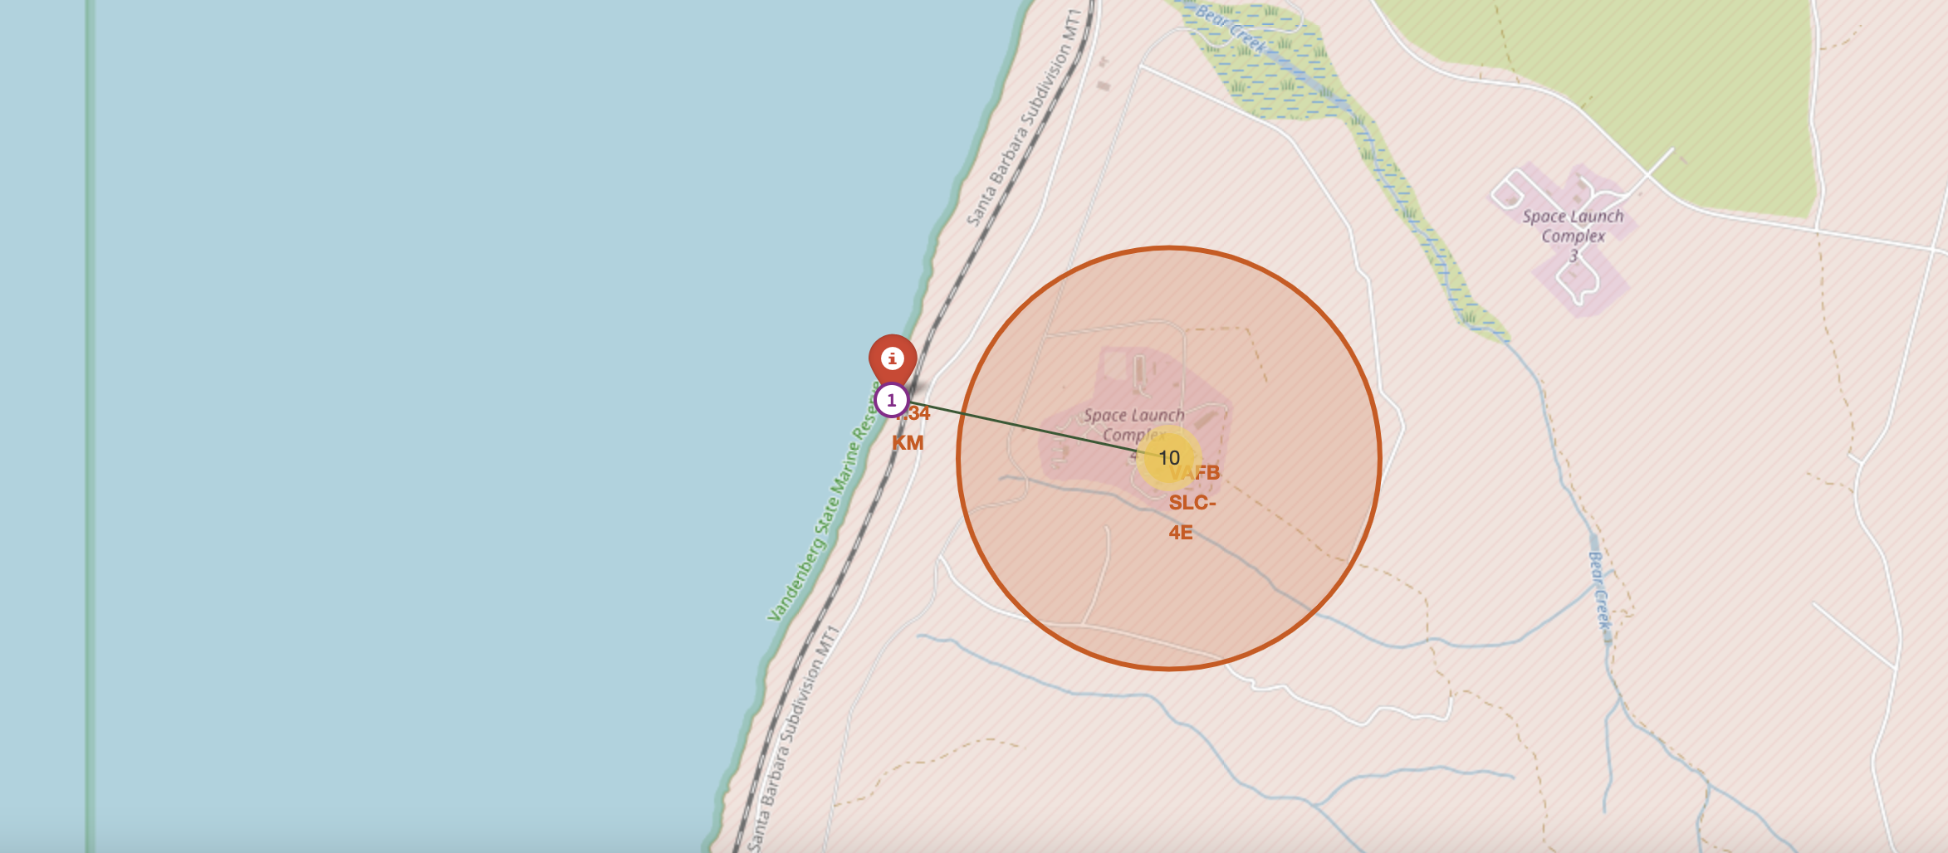
Outline
RESULTS
Folium: Distances Between a Launch Site and its Proximities to City, Railway, or Highway
5
Distances between a launch site to its proximities such as the nearest city, railway, or highway
The picture below shows the distance between the VAFB SLC-4E launch site and the nearest coastline

Slide 33
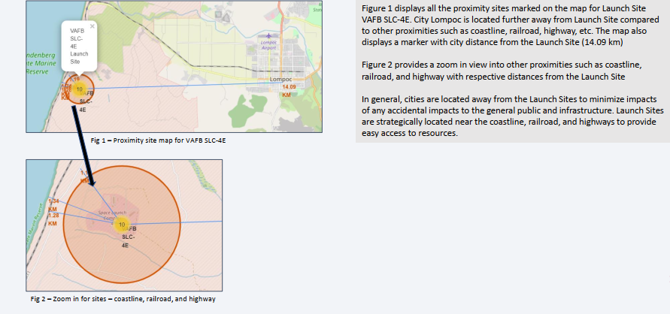
Outline
RESULTS
Folium: Distances Between a Launch Site and its Proximities to City, Railway, or Highway
5
Observation
Figure 1 shows all the proximity sites marked on the map for Launch Site VAFB SLC-4E. City Lompoc is located further away from Launch Site compared to other proximities such as coastline, railroad, highway, etc. The map also exhibit a marker with city distance from the Launch Site (14.09 km)
Figure 2 also provides a zoom in view into other proximities such as coastline, railroad, and highway with respective distances from the Launch Site
Cities or residential areas are located away from the Launch Sites to avoid the impacts of any accidental to the general public and infrastructure. Usually, Launch Sites are strategically located near the coastline, railroad, and highways to provide easy access to resources

Slide 34
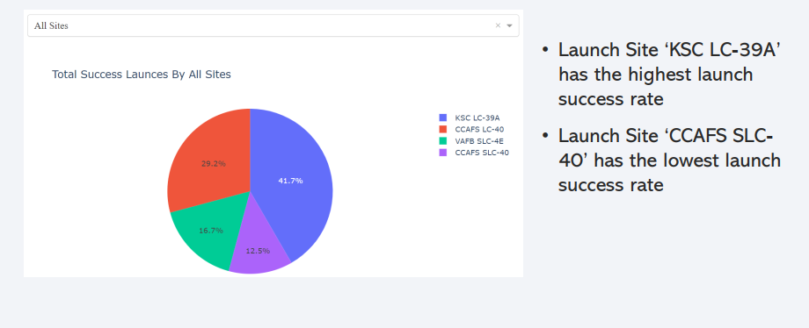
Outline
RESULTS
Dash: Launch Success Counts for all Sites
1
Observation
Comparatively, Launch Site ‘KSC LC-39A’ has the highest launch success rate
Launch Site ‘CCAFS SLC- 40’ has the least launch success rate

Slide 35

Outline
RESULTS
Dash : Successful Count for Launch site CCAFS LC-40
2
Launch site CCAFS LC-40 : 73.1% of launches done at CCAFS LC-40 was successful.

Slide 36
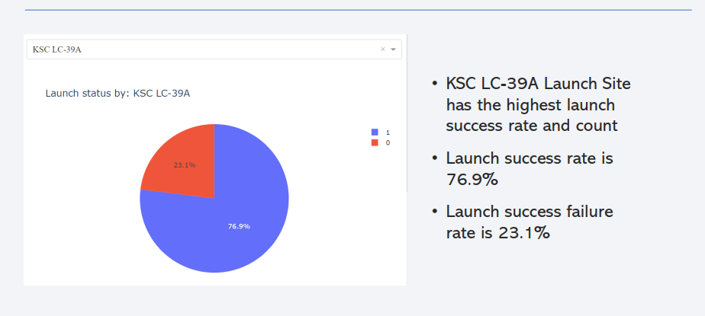
Outline
RESULTS
Dash : Successful Count for Launch site KSC LC-39A Lauch Site
3
Observation
Comparatively, KSC LC-39A Launch Site has the highest launch success rate and count
Launch success rate is approximately 76.9%
Launch success failure rate is about 23.1%

Slide 37
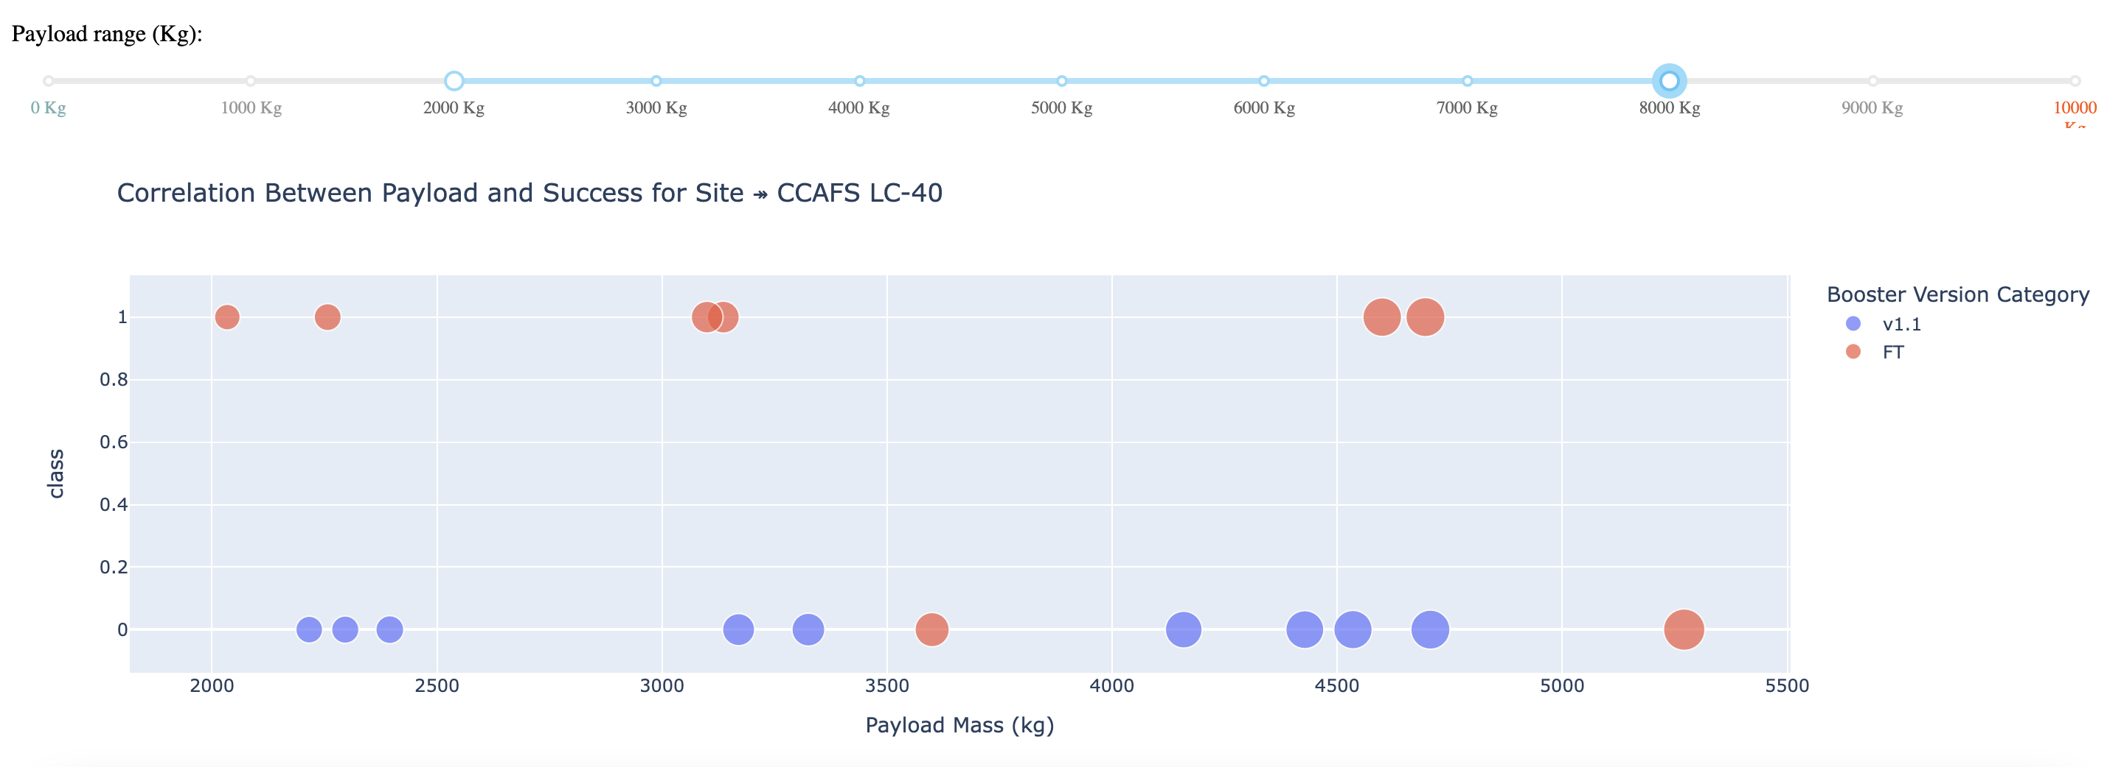
Outline
RESULTS
Dash: Scatterplot of Payload Mass Between 2000kg and 8000kg
4
The picture below shows a scatterplot when the payload mass range is set to be from 2000kg to 8000kg.

Slide 38
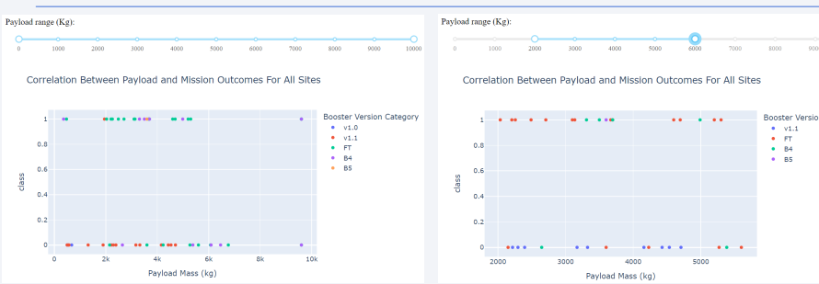
Outline
RESULTS
Dash: Scatterplot of All and Payload Mass Between 2000kg and 8000kg
4
Observation
Most successful launches are in the payload range from 2000 to about 5500
Booster version category ‘FT’ has the most successful launches
Only booster with a success launch when payload is greater than 6k is ‘B4

Slide 39

Outline
RESULTS
Predictive Analysis: Logistic Regression GridSearchCV Evaluation Metrics
1
Logistic regression
GridSearchCV best score: 0.846
Accuracy score on test set: 0.833

Slide 40
Outline
RESULTS
Predictive Analysis: Support Vector Machine(SVM) Evaluation Metrics
2
Support vector machine (SVM)
GridSearchCV best score: 0.848
Accuracy score on test set: 0.833

Slide 41
Outline
RESULTS
Predictive Analysis: Decision Tree Evaluation Metrics
3
Decision tree
GridSearchCV best score: 0.889
Accuracy score on test set: 0.833

Slide 42
Outline
RESULTS
Predictive Analysis: KNN Evaluation Metrics
5
K nearest neighbors (KNN)
GridSearchCV best score: 0.848
Accuracy score on test set: 0.833

Slide 43
Outline
DISCUSSION
From the Analysis above it was discovered/observed that:
The confusion matrix obtained was virtually the same for all the other models (LR, SVM, Decision Tree, KNN)
the classifier made 18 Predictions and 12 scenarios were predicted correctly (Yes for landing), and they did land successfully (True positive)
Three scenarios (top left) were predicted No for landing, and they did not land (True negative)
Three scenarios (top right) were predicted Yes for landing, but they did not land successfully (False positive)
Overall, the classifier predicted correctly for 83% of the time ((TP + TN) / Total) with a misclassification or error rate ((FP + FN) / Total) of about 16.5%
Positive relationship between number of flights and success rate. As the numbers of flights increase, the first stage is more likely to land successfully.
Success rates appear go up as Payload increases but there is no clear correlation between Payload mass and success rates
Launch success rate increased by about 80% from 2013 to 2020

Slide 44
Outline
DISCUSSION
From the Analysis above it was discovered/observed that:
Launch Site ‘KSC LC-39A’ recorded the highest launch success rate whereas Launch Site ‘CCAFS SLC- 40’ recorded the least launch success rate.
Orbits ES-L1, GEO, HEO, and SSO also recorded the highest launch success rates whereas orbit GTO as the least.
Strategically, lunch sites are located away from the cities and mostly closer to coastline, railroads, and highways.
The best performing Machine Learning Classification Model was Decision Tree with accuracy of about 87.5%. When data was tested on the models, the accuracy score was about 83% for all models. Perhaps more data may be needed to further tune the models and find a potential better fit.
Based on the Accuracy scores and EDA analysis, Decision Tree algorithm recorded the highest classification score with a value of .8750.

Slide 45
Thank you

